Slide 1
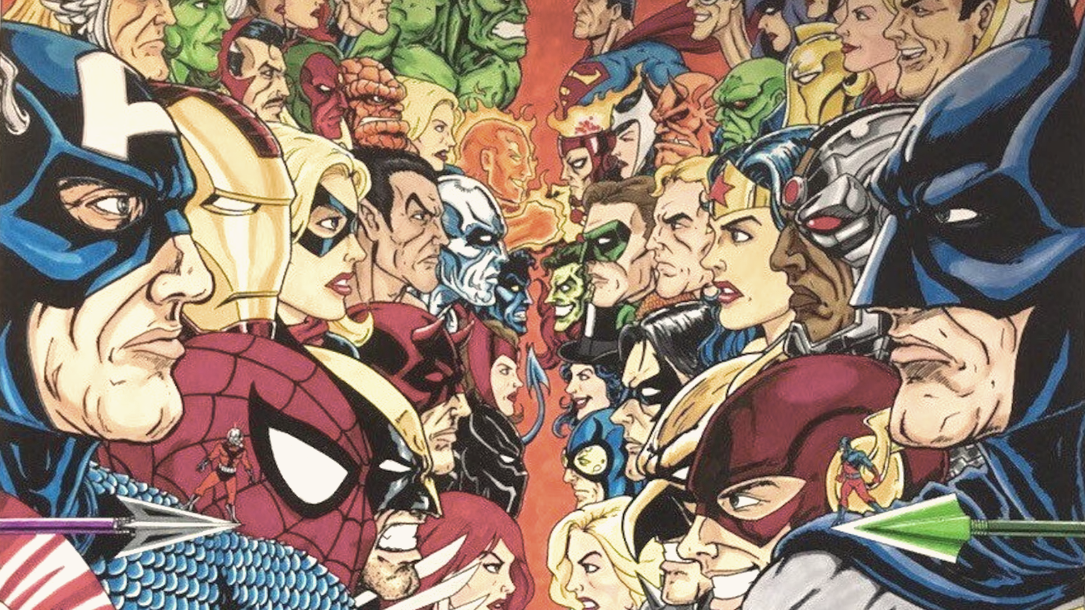
Project #4:
Marvel / DC
Christina Chau
Nitin Dhiman
Robert Harvey
Justin Kiang
Xander Polny
Notes:
Robert - Introduce Project #4, Project Title, and teammates

Slide 2
Presentation Layout
Project Focus
Where we started, and how we landed on this topic
Videogames, Movie Franchise, etc.
Data sources
Notebook
Jupyter, Tableau, Google Collab
Visualizations/Models
Results/So what?
Limitations
Questions
Notes:
Note to Nitin: Will this slide be an overview of our presentation once finalized? If so, I’m good to present this slide and also introduce the entire team on slide #1

Slide 3
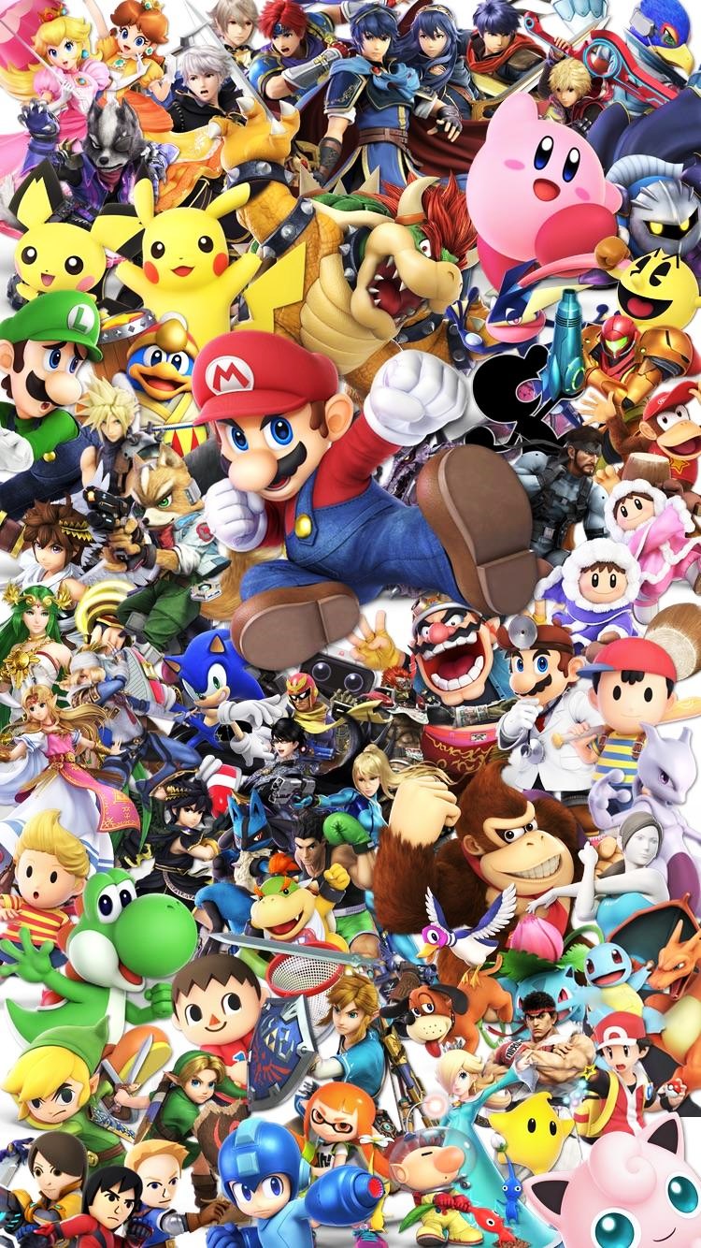
Where We Started
Initially started with looking at Videogames
Developer/Publisher/Genre
Then we began exploring potential movie franchises (Fast and Furious, James Bond, Star Wars, etc.)
Franchise performance
Finally, we landed on Marvel/DC – Good/Bad
Characteristics define morality?
Notes:
Robert - …Our first idea was to look at video games across all platforms to see if we could determine a trend or predict future sales based on a few attributes, mainly developer, distributor, platform (Sony, Microsoft, Nintendo etc.).
After getting stuck and not being able to find datasets to fit, transition to movie franchises
Ended up on comic book characters

Slide 4
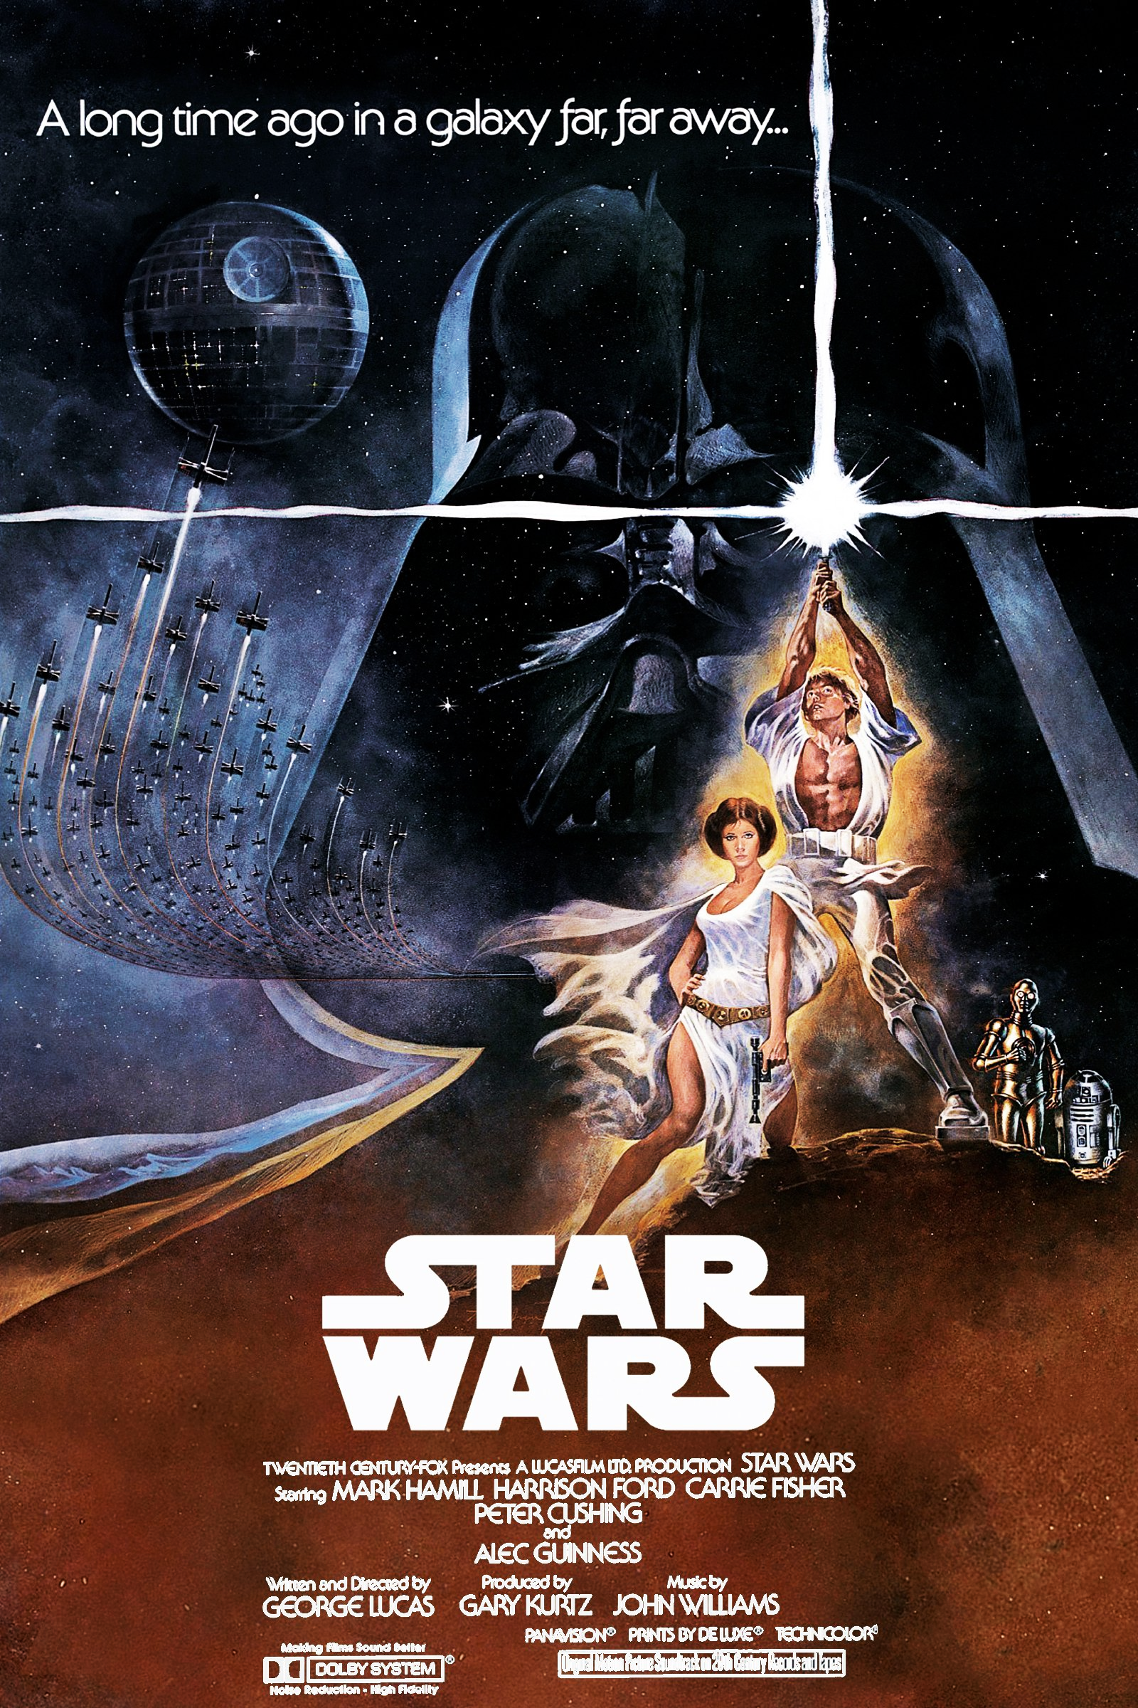
Where We Started
Initially started with looking at Videogames
Developer/Publisher/Genre
Then we began exploring potential movie franchises (Fast and Furious, James Bond, Star Wars, etc.)
Franchise performance
Finally, we landed on Marvel/DC – Good/Bad
Characteristics define morality?
Notes:
Robert - …Our first idea was to look at video games across all platforms to see if we could determine a trend or predict future sales based on a few attributes, mainly developer, distributor, platform (Sony, Microsoft, Nintendo etc.).
After getting stuck and not being able to find datasets to fit, transition to movie franchises
Ended up on comic book characters

Slide 5
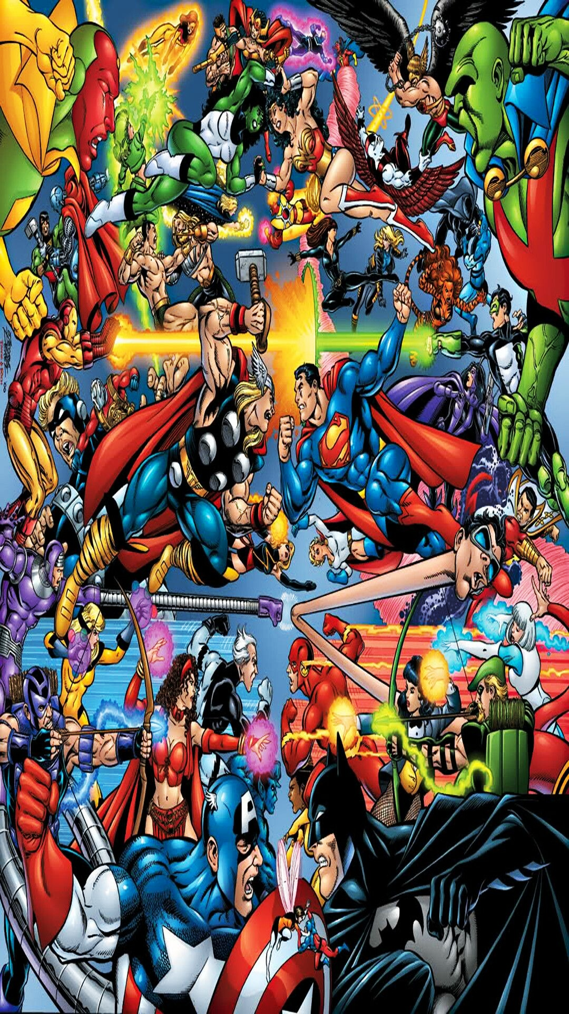
Where We Started
Initially started with looking at Videogames
Developer/Publisher/Genre
Then we began exploring potential movie franchises (Fast and Furious, James Bond, Star Wars, etc.)
Franchise performance
Finally, we landed on Marvel/DC – Good/Bad
Characteristics define morality?
Notes:
Robert - …Our first idea was to look at video games across all platforms to see if we could determine a trend or predict future sales based on a few attributes, mainly developer, distributor, platform (Sony, Microsoft, Nintendo etc.).
After getting stuck and not being able to find datasets to fit, transition to movie franchises
Ended up on comic book characters

Slide 6

Project Focus
Can character traits be an indicator of whether a character is morally “Good” or “Bad”?
Identity
Hair Color
Sex (biological)
Gender/Sexual Preference
Eye Color
Studio
Notes:
Robert - …Explain process of deciding which were the best metrics to use
Number of appearances was one column, ended up not being a good determining factor
Good, Bad, Neutral provided an opportunity to make string/non-numerical data with characteristics such as hair color, eye color, into a predictive model
Using morality as a determining factor, we then were able to come up with a way to use html, flask, sql (through Heroku) to create an App

Slide 7
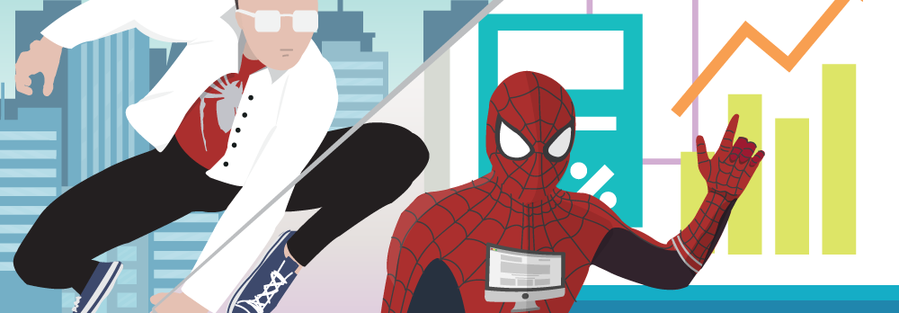
Data Sources
We utilized 2 datasets found on Kaggle
Marvel-wikia-data.csv
DC-wikia-data.csv
Notes:
Justin - We used Kaggle and a variety of other sources while exploring each of our ideas for this project
Ultimately we were able to find two CSV files on Kaggle related to Marvel and DC characters
Some of the columns in both datasets include: share some columns before transitioning to Christina to discuss our ETL process

Slide 8

Extract, Load, Transform
Jupyter Notebook
Loaded Marvel and DC Kaggle CSVs
Cleaned datasets
Added Studio column to differentiate between Marvel vs DC datasets
Concatenated both datasets into one
Created SQLAlchemy engine to link pandas dataframe with PostGreSQL
Notes:
Christina C - Go to Jupyter Notebook

Slide 9
Extract, Load, Transform
Tableau
Loaded Cleaned CSV
Edited some of the dimensions
Groups, Sets, Re-naming, etc.
Created Visualizations
Developed three Dashboards
Constructed a Story
Notes:
Xander - Go to Tableau

Slide 10

Data Model Implementation
Used Google Colab script to:
read CSVs
convert categorical data to numeric
develop ML models
Target was 75%
Started at 50/50
Ended up with ~68%
Notes:
Christina - Go to Google Collab

Slide 11
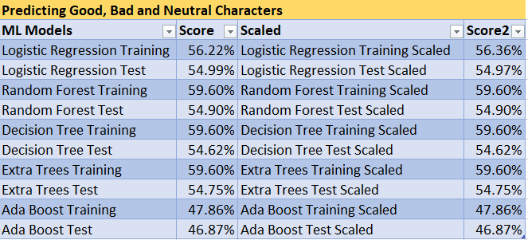
Data Model Optimization
Predictive Model underperformed on our first attempt.
Notes:
Justin

Slide 12
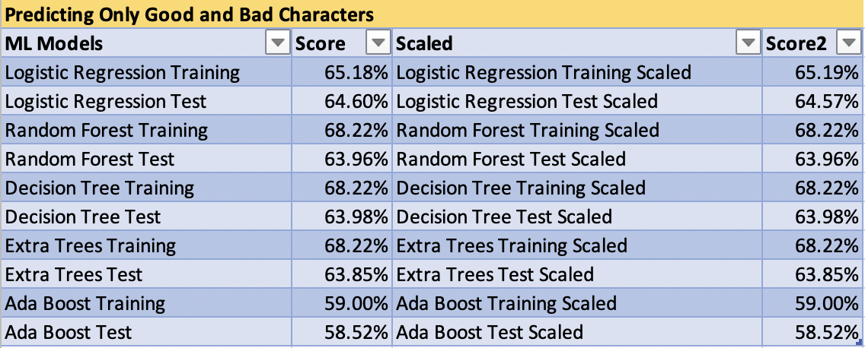
Data Model Optimization
On our second attempt, the model provided much stronger Predictive Validity.
Notes:
Justin

Slide 13
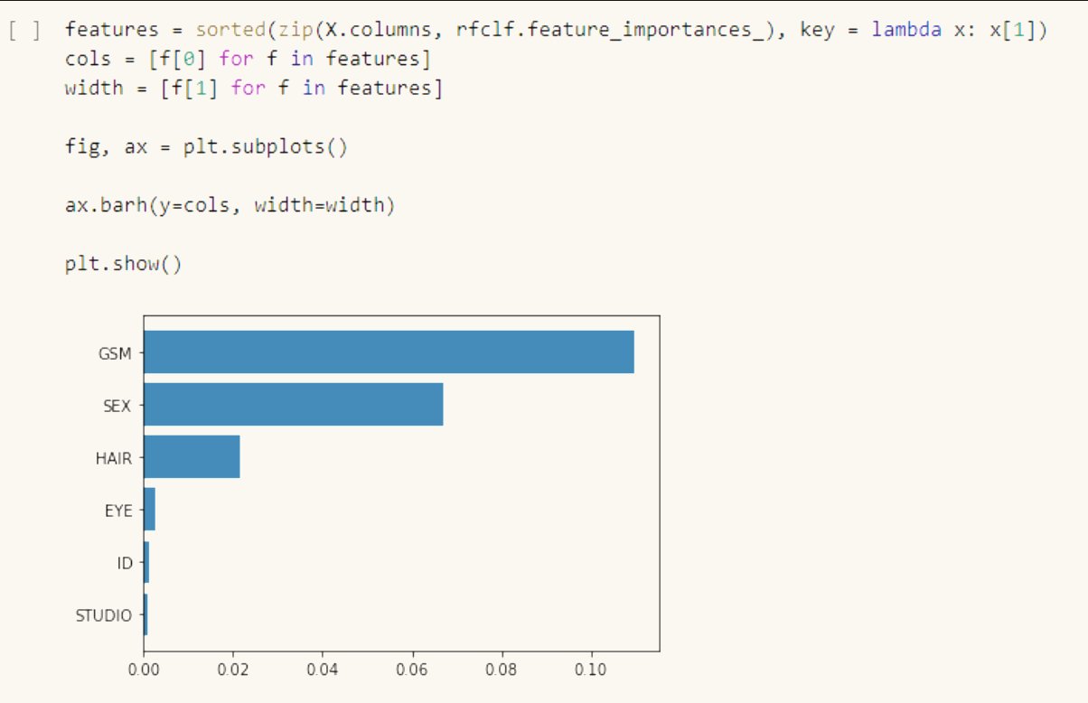
Results
We can conclude that certain characteristics are somewhat (68%) predictive of a comic-book character’s moral compass
Specific traits lean one way or another
GSM was the most important feature within the Random Forest model
Notes:
Justin

Slide 14

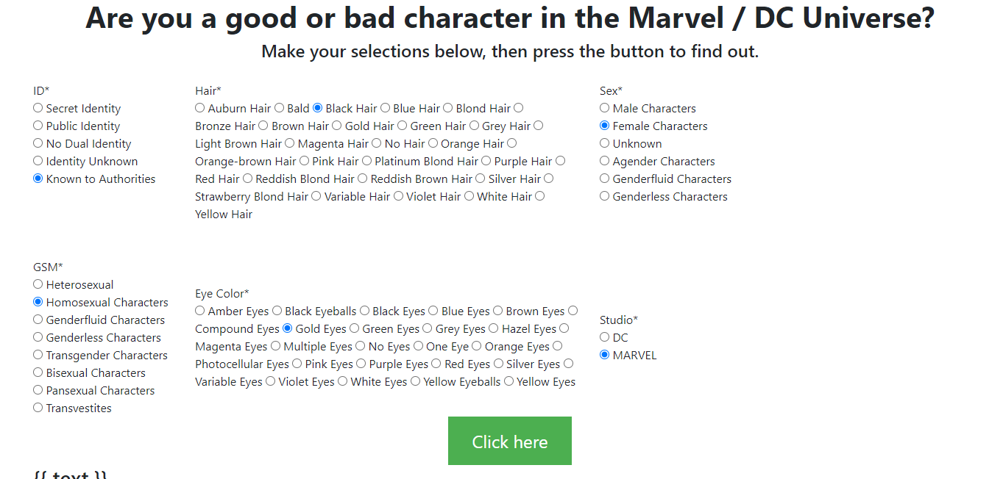
Web Form Using Flask
Create API from the Postgres database
Pass form inputs through app using for loop
Pickle ML model
Notes:
Justin - Go to Flask Application

Slide 15
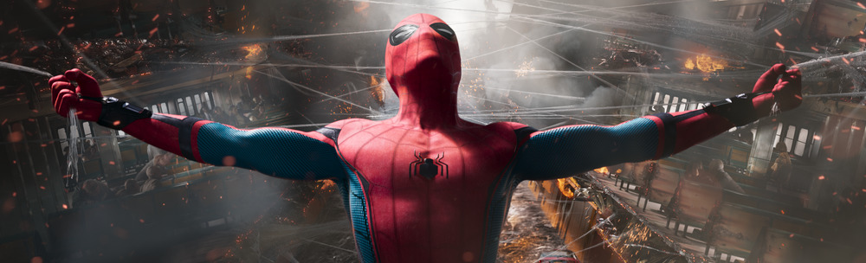
Limitations
Time
Access to specific datasets
Predictive modelling based on string data provides additional challenges
New software/packages we were previously unaware of (.pkl)
Notes:
Nitin

Slide 16

Questions?

